Slide 1
Introduction to Computational Thermodynamics
Section 1.1
Introduction and Review

Slide 2
Introduction
Welcome to the course!
Each session will run from 9am to 12pm BST
They will all be recorded!
We will aim to have a short break during this time, likely around 10:30 each day – feel free to ask questions during this time!
This is a course pilot – things may not be polished, and we would love any feedback about the delivery, material, or content in the pre- and post-course surveys

Slide 3
Overview
There are 3 parts to this course:
Introduction & Review (~1 hour)
Equations of State (~3 hours)
Solving the Problems (~3 hours)
There are also activities for parts 2 and 3

Slide 4
Introduction
The activities are:
Introduction to automatic differentiation
Implementation of a cubic equation of state
Coding of a Rachford-Rice solver
We expect to leave 30 minutes for each activity, and will make sure to have time for any questions or issues you may encounter

Slide 5
Review
So! On to the review
There are a few concepts in thermodynamics it is important to be familiar with
First we should recall the basic thermodynamic variables:

Slide 6
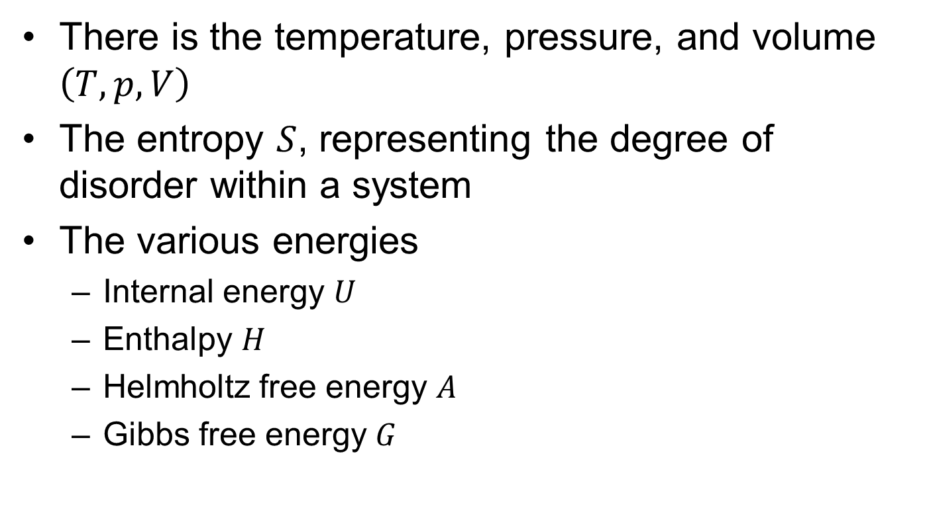
Thermodynamic variables
There is the temperature, pressure, and volume $\left(T, p, V\right)$
The entropy $S$, representing the degree of disorder within a system
The various energies
Internal energy $U$
Enthalpy $H$
Helmholtz free energy $A$
Gibbs free energy $G$

Slide 7
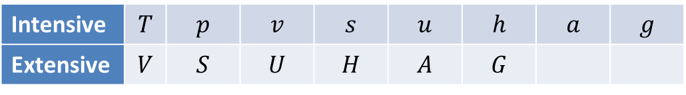
Thermodynamic variables
These are often divided into intensive and extensive variables
An intensive variable is independent of amount, while an extensive quantity increases proportional to amount
All extensive properties can be easily transformed to intensive properties, e.g. volume to specific volume
Intensive | $$T$$ | $$p$$ | $$v$$ | $$s$$ | $$u$$ | $$h$$ | $$a$$ | $$g$$
Extensive | $$V$$ | $$S$$ | $$U$$ | $$H$$ | $$A$$ | $$G$$

Slide 8
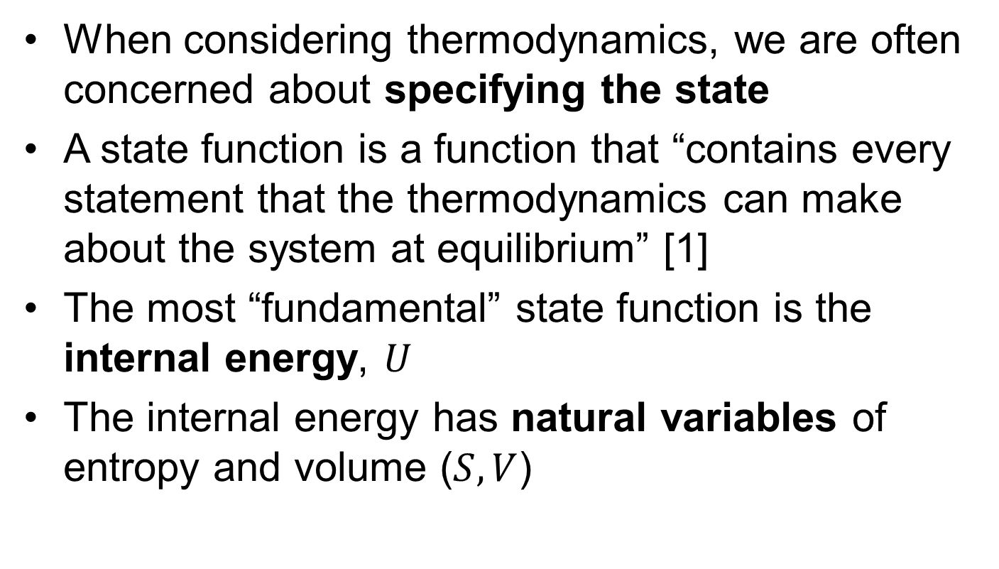
State Functions
When considering thermodynamics, we are often concerned about specifying the state
A state function is a function that “contains every statement that the thermodynamics can make about the system at equilibrium” [1]
The most “fundamental” state function is the internal energy, $U$
The internal energy has natural variables of entropy and volume ($S, V$)
Notes:
When working in thermodynamics, we’re generally concerned with the state of a substance. Beyond just whether the substance is a liquid or a vapour, we also want to know the temperature, pressure, heat capacities – and everything else. So, what do we need to obtain that?
Well, it turns out a simple function can describe all of that. The most fundamental example is the internal energy, which describes the state fully in terms of the entropy and the volume

Slide 9
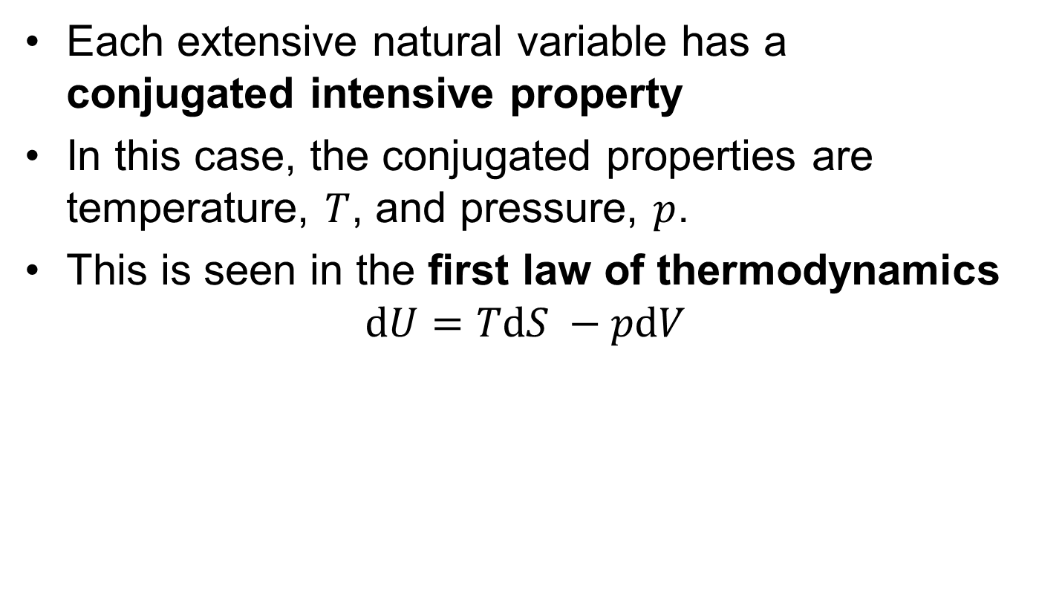
State Functions
Each extensive natural variable has a conjugated intensive property
In this case, the conjugated properties are temperature, $T$, and pressure, $p$.
This is seen in the first law of thermodynamics $dU=TdS −pdV$

Slide 10
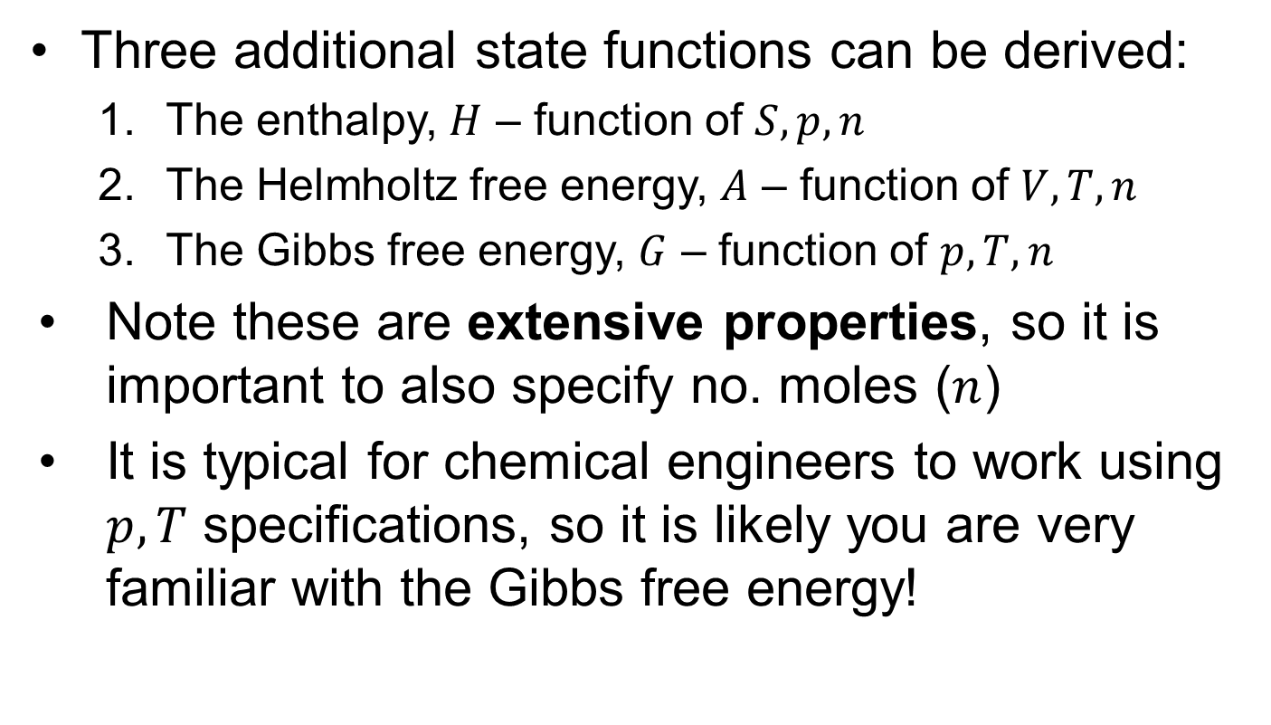
State Functions
Three additional state functions can be derived:
The enthalpy, $H$ – function of $S, p, n$
The Helmholtz free energy, $A$ – function of $V, T, n$
The Gibbs free energy, $G$ – function of $p, T, n$
Note these are extensive properties, so it is important to also specify no. moles ($n$)
It is typical for chemical engineers to work using $p, T$ specifications, so it is likely you are very familiar with the Gibbs free energy!

Slide 11
Derivatives of State Functions
Each state function fully describes the state, but initially it is not obvious how to leverage this
By taking derivatives of our state function, every other property is easily obtainable

Slide 12
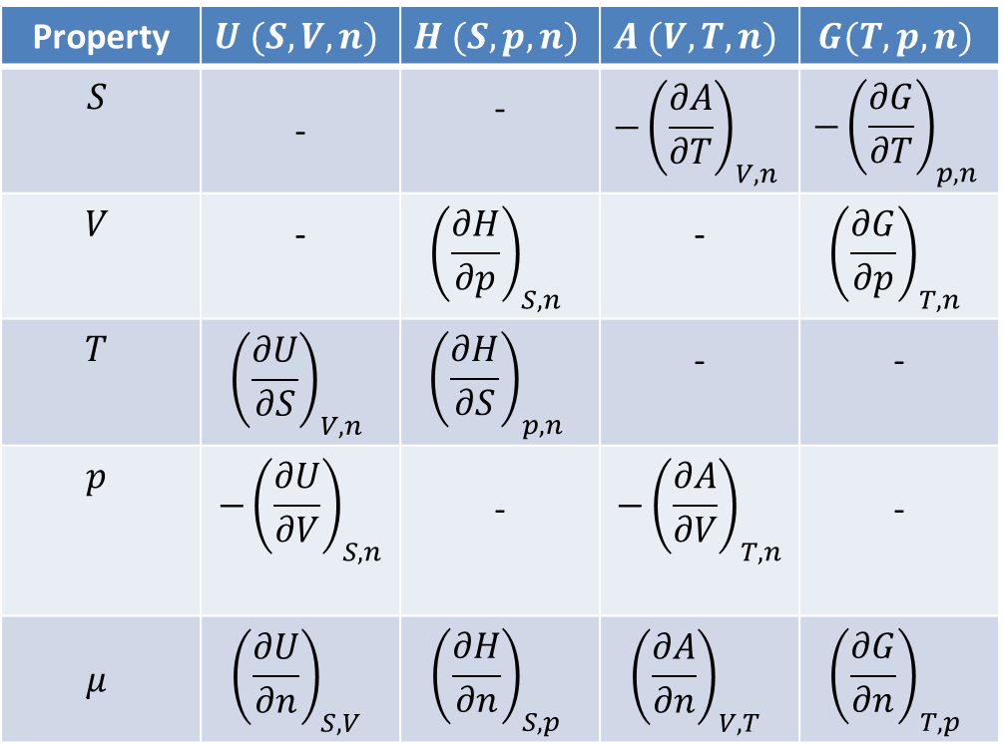
Derivatives of State Functions
Property | $$U (S,V,n)$$ | $$H (S,p,n)$$ | $$A (V,T,n)$$ | $$G(T,p,n)$$
$$S$$ | - | - | $$−{\left(\frac{∂A}{∂T}\right)}_{V, n}$$ | $$−{\left(\frac{∂G}{∂T}\right)}_{p,n}$$
$$V$$ | - | $${\left(\frac{∂H}{∂p}\right)}_{S, n}$$ | - | $${\left(\frac{∂G}{∂p}\right)}_{T,n}$$
$$T$$ | $${\left(\frac{∂U}{∂S}\right)}_{V, n}$$ | $${\left(\frac{∂H}{∂S}\right)}_{p, n}$$ | - | -
$$p$$ | $$−{\left(\frac{∂U}{∂V}\right)}_{S, n}$$ | - | $$−{\left(\frac{∂A}{∂V}\right)}_{T, n}$$ | -
$$μ$$ | $${\left(\frac{∂U}{∂n}\right)}_{S, V}$$ | $${\left(\frac{∂H}{∂n}\right)}_{S,p}$$ | $${\left(\frac{∂A}{∂n}\right)}_{V, T}$$ | $${\left(\frac{∂G}{∂n}\right)}_{T,p}$$
[1]
Notes:
We can see that we take the derivative of the internal energy with respect to the entropy, and we obtain the temperature. The derivative with respect to volume, and we obtain the pressure. In this way, every state function can be related to a whole variety of properties.

Slide 13
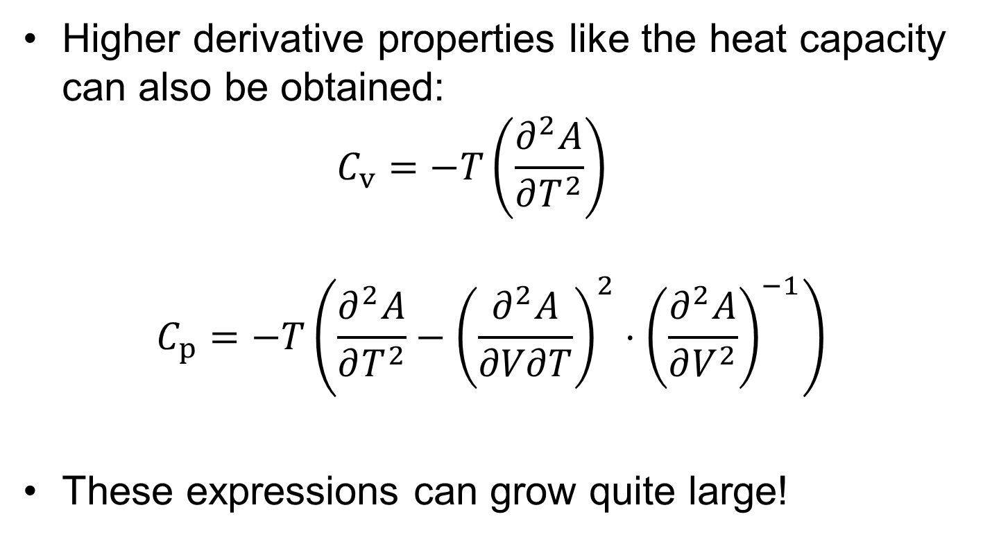
Derivatives of State Functions
Higher derivative properties like the heat capacity can also be obtained: $C_{v}=−T\left(\frac{∂^{2}A}{∂T^{2}}\right)$
$$C_{p}=−T\left(\frac{∂^{2}A}{∂T^{2}}−{\left(\frac{∂^{2}A}{∂V∂T}\right)}^{2}⋅{\left(\frac{∂^{2}A}{∂V^{2}}\right)}^{−1}\right)$$
These expressions can grow quite large!
Notes:
On top of that, it is not juts limited to those 5 variables. By taking higher order derivatives, we can express the isochoric and isobaric heat capacities just in terms of a state function.

Slide 14
Applications to Equations of State
These derivative relations form the basis for the fundamental structure of Clapeyron.jl, the package underpinning much of this course
By defining a single relation, we can slot any equation of state into a universal format, differentiating it to obtain properties of interest
The question is now which state function to use!
Notes:
This idea of a single state function being able to define every possible property is part of the fundamental structure of Clapeyron. In Clapeyron, there is a universal format applicable to any class of equation of state. This allows for a lot of flexibility and makes for a very powerful framework. But which state function does Clapeyron use? We saw four different ones to choose from, so how should we decide?

Slide 15
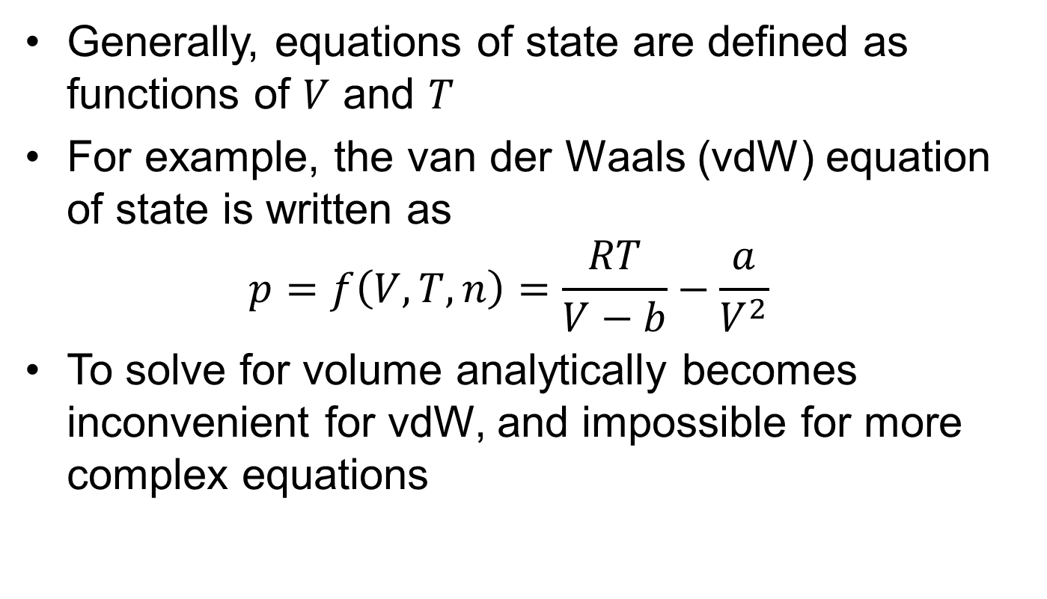
Applications to Equations of State
Generally, equations of state are defined as functions of $V$ and $T$
For example, the van der Waals (vdW) equation of state is written as $p=f\left(V,T,n\right)=\frac{RT}{V−b}−\frac{a}{V^{2}}$
To solve for volume analytically becomes inconvenient for vdW, and impossible for more complex equations

Slide 16
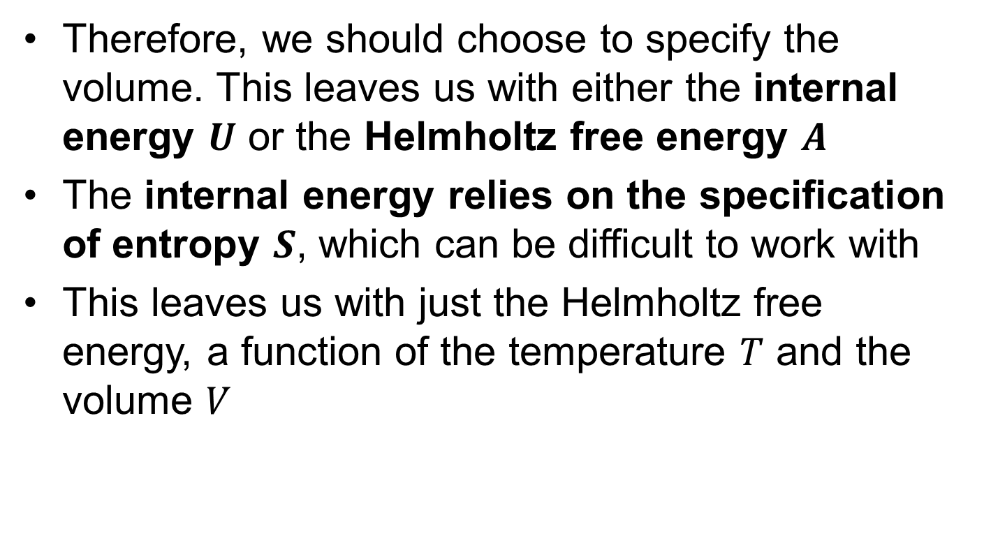
Applications to Equations of State
Therefore, we should choose to specify the volume. This leaves us with either the internal energy $U$ or the Helmholtz free energy $A$
The internal energy relies on the specification of entropy $S$, which can be difficult to work with
This leaves us with just the Helmholtz free energy, a function of the temperature $T$ and the volume $V$

Slide 17

Helmholtz free energy
The Helmholtz free energy is the common interface by which every equation of state defined within Clapeyron is defined!
This function is called $eos$, and almost any call to a function within the package will pass through it

Slide 18
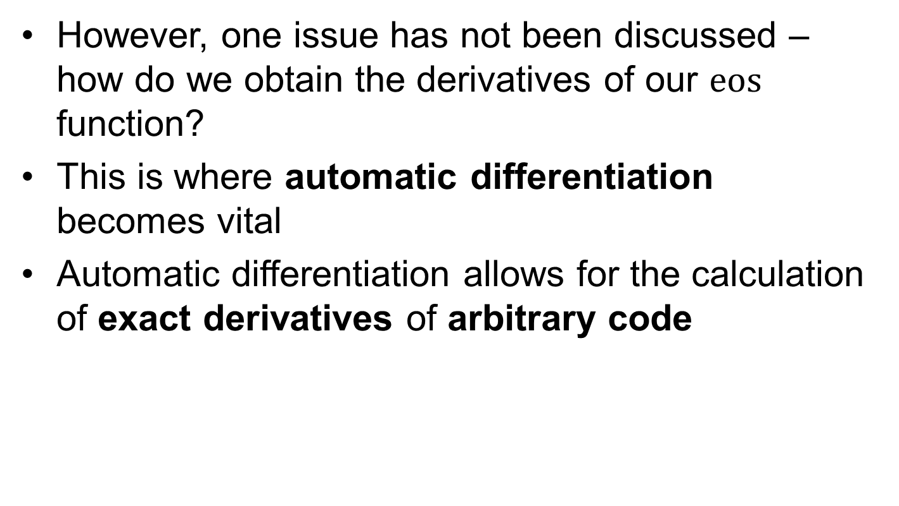
Obtaining derivatives
However, one issue has not been discussed – how do we obtain the derivatives of our $eos$ function?
This is where automatic differentiation becomes vital
Automatic differentiation allows for the calculation of exact derivatives of arbitrary code

Slide 19
Automatic Differentiation
Automatic differentiation, or “autodiff”, uses the fact that any computer program is reducible to a series of elementary operations (i.e. +-*/)
By tracing the operations performed by the code, the program can then determine the equivalent exact derivative – even if no single closed-form solution exists!

Slide 20
Automatic Differentiation
Autodiff is incredibly important in modern computing
While an established tool in neural networks and artificial intelligence, the application of it to thermodynamics is still cutting-edge
In particular, we are now able to obtain fast and exact derivatives previously never touched. These are used extensively in section 3

Slide 21
Automatic Differentiation
There are two modes of autodiff; reverse-mode and forward-mode
While performing fundamentally the same task, forward-mode is usually more efficient for small problems (< 100 variables), while reverse-mode is more typical in very large problems
It’s incredibly unlikely to encounter thermodynamics problems with over 100 variables – therefore, forward-mode is the algorithm of choice for Clapeyron and this course

Slide 22
Key Points
Clapeyron uses the Helmholtz free energy as a universal interface for equations of state
By differentiating the Helmholtz free energy, every other property of interest can be obtained
Automatic differentiation enables exact and efficient derivates for arbitrary code

Slide 23
Citations
[1]: Thermodynamic Models: Fundamentals and Computational Aspects, Michael L. Michelsen & Jorgen Mollerup

